Slide 1
Authoring Profiles
Ewout Kramer
january 2014

Slide 2
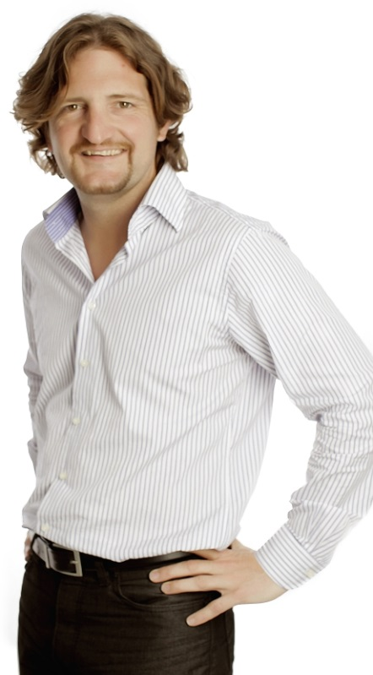
Who am I?
Name: Ewout Kramer
Company: Furore, Amsterdam
Background:
FHIR core team, RIMBAA
Software developer & healthcare architect
Contact:
e.kramer@furore.com
www.thefhirplace.com

Slide 3
Introduce ourselves
Who has looked at Profile in the spec?
Who has near-future needs for authoring profiles?
Who’s comfortable looking at XML?

Slide 4
Contents of this tutorial
Intro to Profiles
Extensions
Restrictions
Bindings & ValueSets
Slicing
Aggregation
A combined example

Slide 5
The need for Profiles
Many different contexts in healthcare, but a single set of Resources
Need to be able to describe restrictions based on use and context
Allow for these usage statements to:
Authored in a structured manner
Published in a repository
Used as the basis for validation, code, report and UI generation.

Slide 6
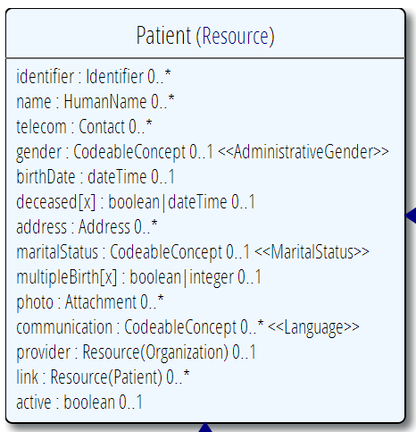
Profiling a resource
Demand that the identifier uses your national patient identifier
Limit names to just 1 (instead of 0..*)
Limit maritalStatus to another set of codes that extends the one from HL7 international
Add an extension to support “RaceCode”
Note: hardly any mandatory elements in the core spec!

Slide 7
Structured & published
A Profile is just a “normal” Resource
Any FHIR server could serve Profiles (just like Patients, Observations, etc…)
So, any FHIR server is a profile repository!
A resource is simply referred to by its URI:
e.g. http://hl7.org/fhir/Profile/iso-21090

Slide 8
Using profiles
When communicating a resource, you can indicate the profiles it conforms to.
A server might explicitly state it only accepts resources conforming to a certain profile (and verify!)
You can ask a FHIR server to validate a resource against a given profile

Slide 9
Tagging a Resource
Patient
MRN 22234
“Ewout Kramer”
30-11-1972
Amsterdam
http://hl7.org/fhir/tag/security
http://hl7.org/fhir/v3/ActCode#TABOO
http://hl7.org/fhir/tag http://example.org/fhir/Status#Test
http://hl7.org/fhir/tag/profile http://hl7.org/fhir/Profile/us-core
“a claim that the Resource conforms to the profile identified in the term”

Slide 10
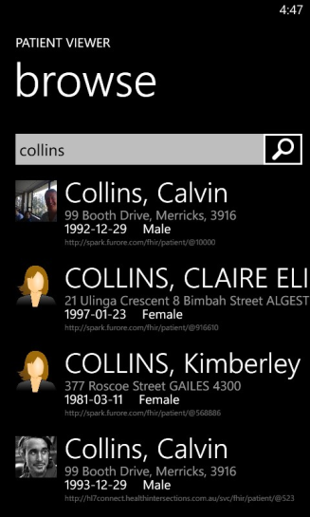
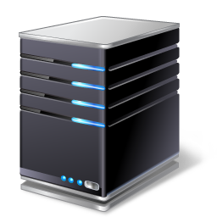
(Distributed) validation
App’s server
Store &
Validate
Country validation server
Validate
Profile X
Profile Y
Profile Y
Validate
Notes:
A server might defer validation to another server (because it doesn’t know the profile)
A server may fetch the “unknown” profile and validate it itself
There may be several servers sharing the work

Slide 11

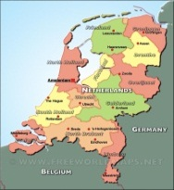

Who publishes?
http://www.hl7.org/fhir/Profile/iso-21090
http://www.hl7.nl/fhir/Profile/patient-nl
http://www.health4all.org/fhir/Profile/
Notes:
“Drive-by” or “bottom-up” operability: “Communicate first, standardize later”
First, business partners. Then, collaborations, communities. Maybe, finally, nation-wide
It’s a natural process that people will want to make it work first, then only coordinate what they really need to, and then realize they can broaden their approach to a community.
“Support”, of course top-down should still be possible! Maybe even a combi in the long-term

Slide 12
What’s in a profile?
Conformance
Metadata
Identifier
Name, Version
Publisher
Description, Code
Status
Date (of publication)
Resource and Datatype Constraints
Resource (via Tag)
Extension
Extension in Resource
ValueSet
ValueSet

Slide 13
Scale / design
Make a profile with just extensions
Make a profile with just 1 resource + extensions on that resource
Make a profile with all (say national) resources + extensions.

Slide 14
Profile metadata
Identifier: Universally unique identifier, assigned by author value=“urn:hl7.org:extensions:iso-21090“ or “2.16.840.1.113883.10.20.2.1”
Version: Version of the profile, manually maintained by author. Suggested format: a timestamp (e.g. 2013-01-01T12:34:45)
Name: Free natural text name (e.g. “ISO 21090 Data Type Extensions”)
Publisher: organization or individual responsible for publishing. Should be populated (e.g. “FHIR Project Team“)
Telecom: one or more contact points of the publisher (telephone, email, website etc)
Description: longer description of the contents of the profile
Code: one or more coded descriptions to help with finding the profile
Status (fixed choice of draft, active, retired) + experimental Y/N
Requirements: scope & usage (the “need” or “why” of the profile)
Date (of publication), e.g. “2013-07-07"

Slide 15
Authoring a Profile
Let’s do this in Forge

Slide 16
Extensions
Design for the 80% - Allow easy extension for the remaining 20% of elements
Note - You’re not extending a resource per se, but you specify where an extension may occur:
A specific element within a resource (even root)
A specific element within a datatype
All elements referencing a datatype
All elements mapping to a specific mapping target
An extension

Slide 17
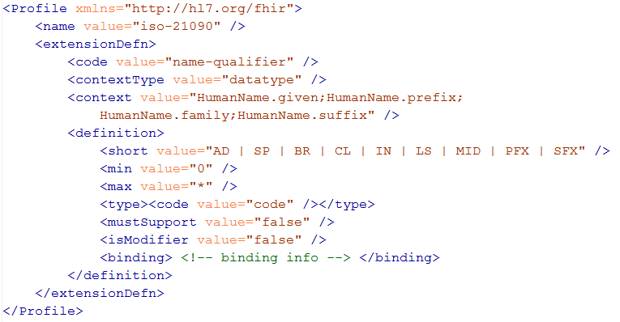
Extension definition
Note: multiple
contexts!

Slide 18
Must support?
Authors: SHALL be capable of providing a value for the element and resource
Consumers: SHALL be capable of extracting and doing something useful with the data element.
"Something useful" is context dependent. The Profile SHALL describe what it means for applications to “support” the element
Notes:
* Note: the spec *never* sets this to true, since it’s context dependent.

Slide 19
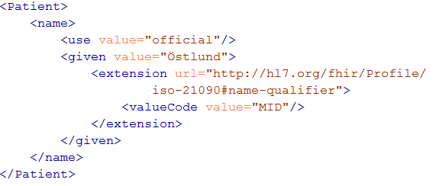
Extending a name
Key = location of formal definition
Value = value according to definition

Slide 20
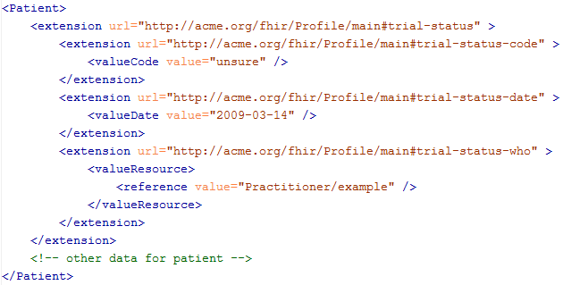
Extending an extension?

Slide 21
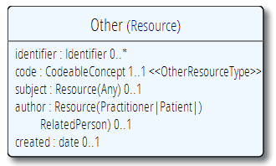
The “Other” resource
Now, what if you have the need for a completely “new” resource?
…then add extensions for each element

Slide 22
Authoring an extension
Let’s do this in Forge

Slide 23
Constraints
Profiles contain “Structures”: a set of constraints on (nested) elements of a Resource or Datatype
You give each structure a “name”, so you can refer to it (e.g. from a Profile Tag)
You can make structures “internal”: local to the package for purpose of reuse
Datatype constraints are always done for reuse of constraints

Slide 24
Constraining cardinality
Limit cardinality to 1..2
(e.g. to at maximum your organizations’ identifier + the national one)
1..2
1..1
0..0
Limit names to just 1 (instead of 0..*)
Forbid any telecom elements
Note: something that’s mandatory in the core definition cannot be made optional in a profile

Slide 25
Limit value domains
If deceased is given, it must be a dateTime, not a boolean
AddressNL
Use a profiled datatype (from this or other profile)
OrganizationNL
=“true”
Only allow reference to a profiled resource
Only allow “active” Patients

Slide 26
Contextualize narrative
Override the base spec’s descriptions by adding context specific narrative:
short : string 1..1
formal : string 1..1
comments : string 0..1
requirements : string 0..1
synonym : string 0..*
example[x] : 0..1 (example value!)
mappings : 0..* (more specific mappings)

Slide 27
Profiling bindings
Depending on “core” spec, you can:
“fixed”: not specify a different binding
“incomplete”: specify a different binding if needed
“example”: very likely specify a different binding
Change the bindings as specified in core:
Define a new ValueSet
Allow additional codes, Restrict to a subset
Specify whether implementers of your profile can deviate from your valueset.

Slide 28
Conformance levels
If implementers of your profile choose to have different codes:
 | IsExtensible “N” | IsExtensible “Y”
Required “SHALL” | Validation error, non-conformant | Additional codes allowed
Preferred “SHOULD” “Guidance” | Validation warning, discouraged | Supplemental codes likely Alternatives allowed
Example “MAY” | Just a suggestion, no preference

Slide 29
ValueSets
A “true” FHIR ValueSet resource (may be version specific)
A general reference to some web content that defines a set of codes. (e.g. mime types).
A textual description of the possible codes

Slide 30
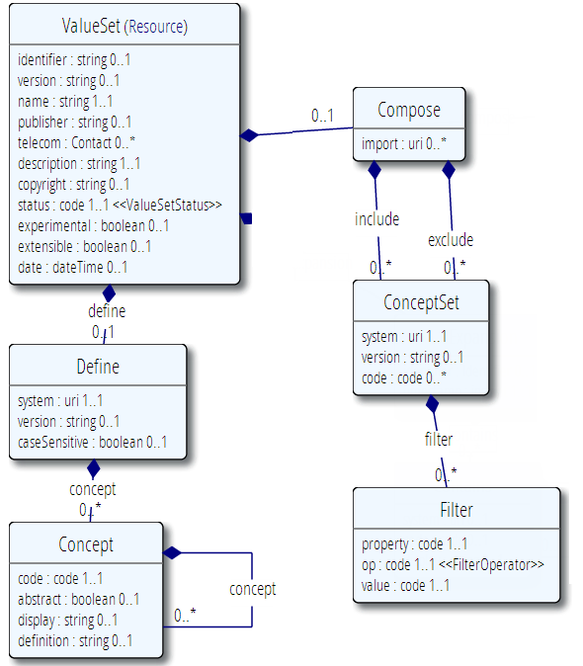
Publication meta-data
Concepts from 1 or more existing systems
Additional concepts

Slide 31
Constraining Patient
Let’s try this in Forge
Example:
Structure on Patient, name “PatientNL”
Limit Patient.identifier cardinality to 1..1
Change short description to “Dutch BSN”
Fix value of Patient.identifier.system to “urn:oid:2.16.840.1.113883.2.4.6.3”

Slide 32
Add formal constraints
Invariants, co-occurrence
Uses free text (human) + xpath (executable)
Constraints should be declared on lowest element in the hierarchy that is common to all nodes referenced by the constraint.
Identified by (local) id, involved elements refer to that id
Specify severity (“error” or “warning”)

Slide 33
Formal constraint example
“Patient’s birthDate < deceasedDate”
Express as text and xpath (left as an exercise to the reader ;-)
Common context for both elements is Patient itself -> add constraint to Patient (give an id, say “1”)
Add reference to constraint “1” on both the birthDate and deceasedDate element

Slide 34
Slicing
Schematic view of Composition (aka a Document header)
Composition
type: CodeableConcept
Section
code: CodeableConcept
content: Resource(Any) 0..1
0..*
Slicing = constraining a repeating element
Base Composition has 0..* “Sections”
Section has 0..1 element with content

Slide 35
Slicing into a CCD
Composition
type = “34133-9” “Summarization of
episode note”
Section
code = 42348-3 (“Advance directives”)
Section
code =11450-4 (“Problem list”)
…
Section
code = 18776-5 (“Treatment plan”)
“Slice” the repeating sections into a fixed set of profiled sections.
“code” is fixed and is called the discriminator

Slide 36
Authoring slices
Let’s do this in Forge

Slide 37
Resources are a network
DiagnosticReport
Practitioner
Practitioner
Location
Observation
Observation
Observation
Organization
Patient
Device

Slide 38
What’s contained in your document or message?
DiagnosticReport
Practitioner
Practitioner
Location
Observation
Observation
Observation
Organization
Patient
Device

Slide 39
What’s in your document?
Observation
DiagnosticReport
Practitioner
Observation
Location
Observation
Practitioner
Patient
Device
Organization

Slide 40
Aggregation
Aggregation: for each ResourceReference choose 1..3:
Code | Definition
contained | Reference to a contained resource.
referenced | Reference to to a resource that has to be resolved externally
..bundled | Reference points to will be found in the same bundle

Slide 41
Try it all
Define a message that contains a Blood-pressure measurement
Questions:
What components will our Profile contain?
Is Patient present in the message?

Slide 42
Possible solution
List-Bloodpressure
subject: Patient|..|.. 0..1 ->
Patient (1..1)
(bundled | ref)
MessageHeader
event: Coding
data: Any(0..*) -> List(1..1)
Entry
item: Observ. (1..1) (bundled)
Entry
item: Observ. (1..1) (bundled)
Observation-Systolic
name: “Systolic”
value: Quantity
(value.units “mmHg”)
Observation-Diastolic
name: “Diastolic”
value: Quantity
(value.units “mmHg”)

Slide 43
Questions?

